Slide 1
SCHOOLS
MBA MEMBERS
EMPLOYERS
SPONSORS
BE IN BRILLIANT COMPANY

Slide 2
AMBA Russia

Slide 3
AMBA Russia

Slide 4
The Global MBA Market - Statistics
2015 vs 2014
Applications | +5.2%
Enrolments | -0.1%
91% of AMBA Schools completed the Survey

Slide 5
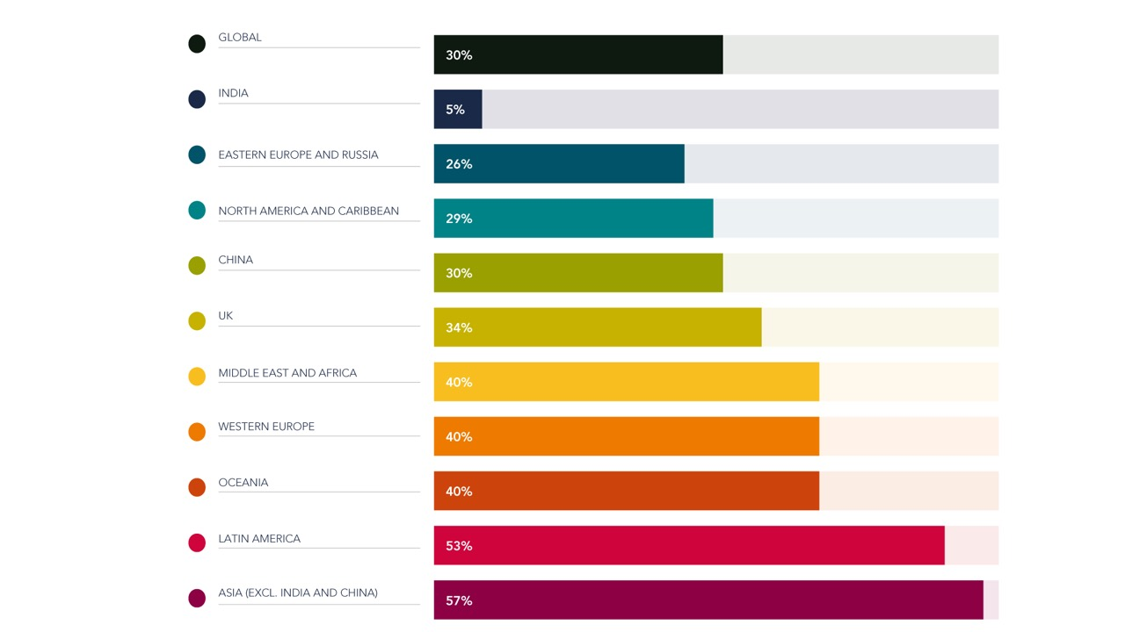
Conversion Rates Applications : Enrolments

Slide 6
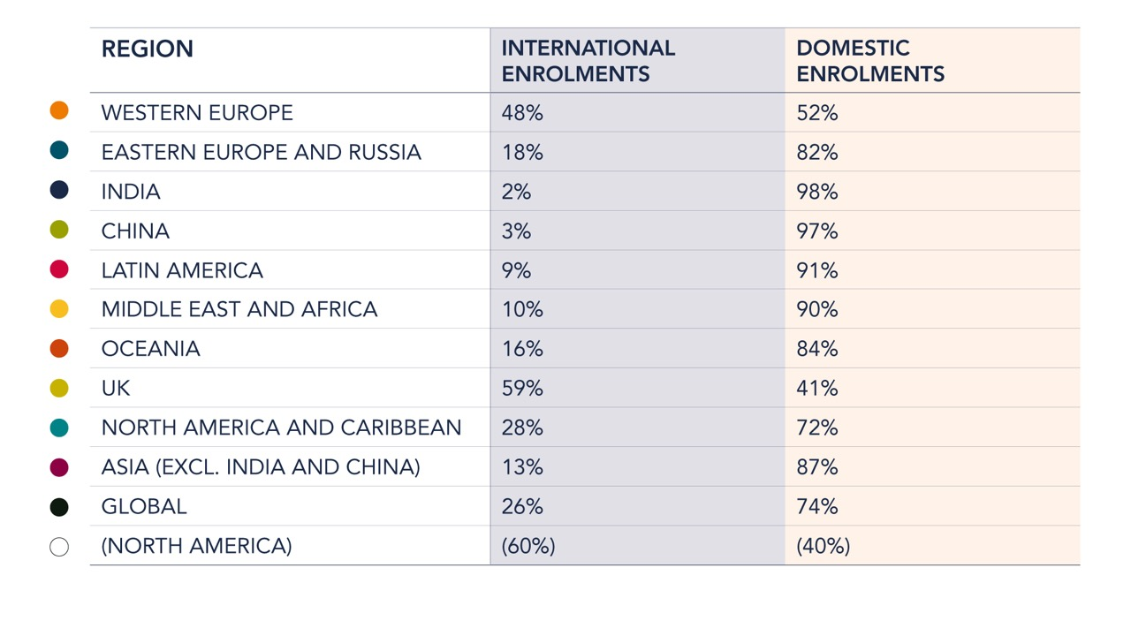
Cohort Mix
Local : International Students

Slide 7
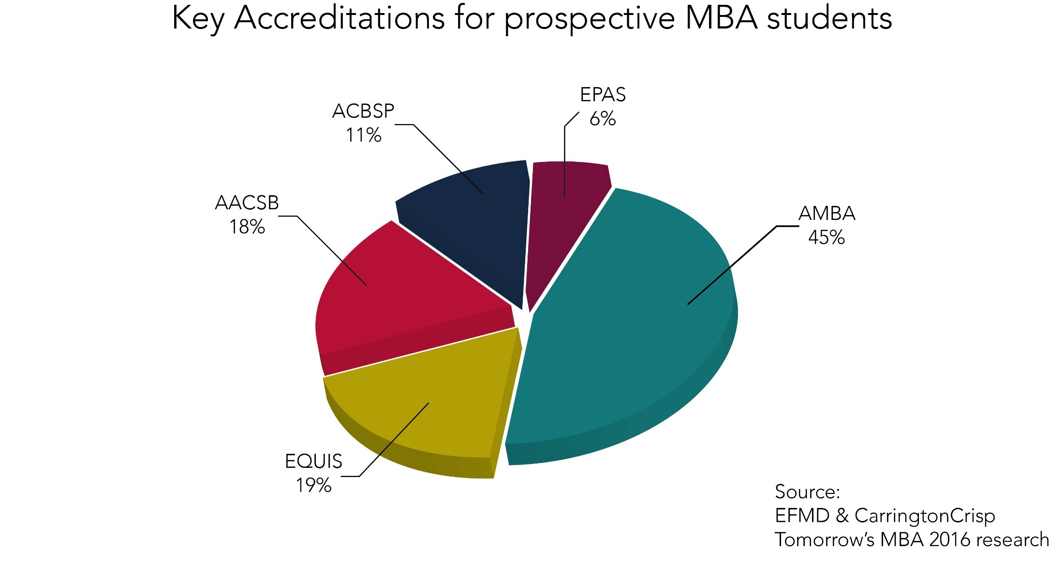
The Most Powerful Brand
1,000 prospective MBA students

Slide 8
Membership Growth to over 28,000

Slide 9
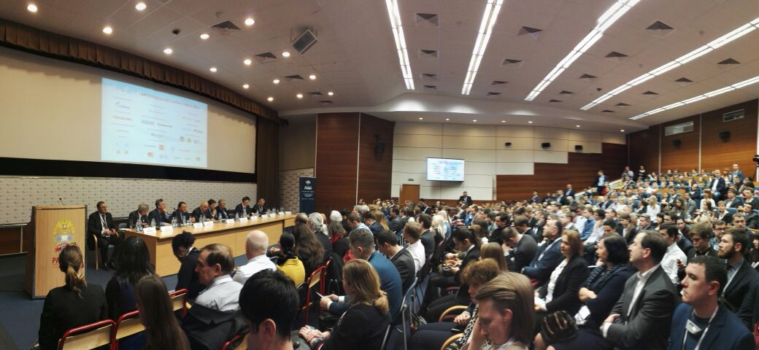
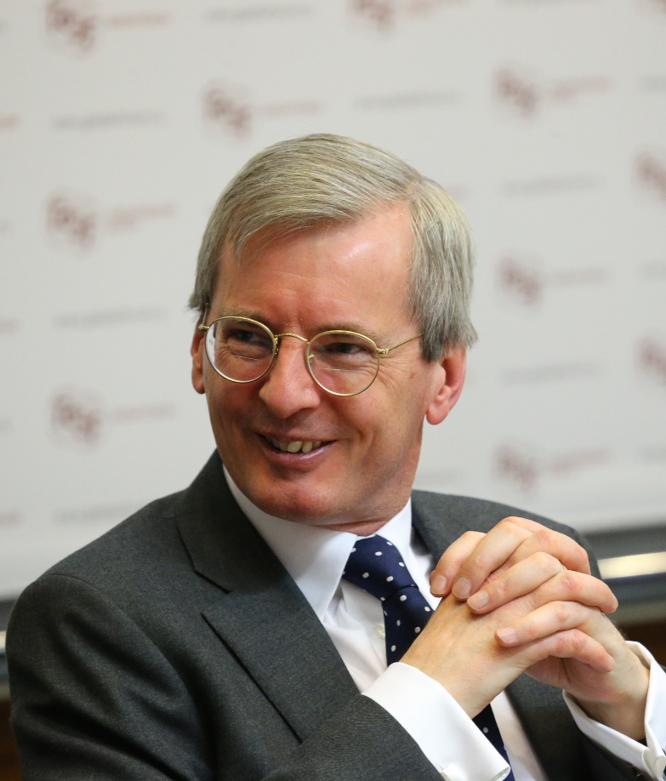
AMBA Russia - Events
AMBA Moscow, January 2017
310 Students & Graduates + Deans & CEOs
Dr Laurie Bristow
British Ambassador to Russia
MBA Graduate, Open University

Slide 10
New – launched October 2015
Global AMBA membership community, for Schools not yet Accredited
Access to AMBA research and data reports, AMBITION magazine and MBA international benchmarking analysis
ADN Community – form partnerships, post jobs, share case studies
AMBA Conferences – reduced rates

Slide 11
Best Practices –
International Benchmarking
1. Business School Distinctiveness/Differentiation

Slide 12
Distinctiveness/Differentiation
SP Jain (India) - summer internship in poor rural village
Zhongnan University (China) – 3 month military leadership & strategy training, run by Chinese Army
LBS (England) - business ethics visit to prison
Kedge (France) - wine MBA specialisation
Toulouse (France) - Aerospace MBA

Slide 13
Best Practices –
International Benchmarking
1. Business School Distinctiveness/Differentiation
2. Entrepreneurship

Slide 14
Entrepreneurship
Incubators and Accelerators
LBS (England) - on-campus incubator
ESADE (Spain) - on-campus Creapolis accelerator
Funding
Warwick (England) - Alumni finance MBA start-ups, via crowdfunding platform
Curriculum Innovation
INSEAD (France) - pairs MBA students with scientists to work on research/patent to commercialisation

Slide 15
Best Practices –
International Benchmarking
1. Business School Distinctiveness/Differentiation
2. Entrepreneurship
3. Careers Support & Placement

Slide 16
Careers Support & Placement
IIMs (India) - senior MBA students mentor junior MBAs in CV writing and interview preparation
European Schools use “dual job search track” for international students (in Europe + their home country)
IESE (Spain) host Latin America Careers Fair
London Business School (England) host Asia Careers Fair

Slide 17
Best Practices –
International Benchmarking
Business School Distinctiveness/Differentiation
Entrepreneurship
Careers Support & Placement
Online Learning
Blended Programmes
Research Plans
Internationalisation
Corporate Relationships
New Course Themes

